Slide 1

Challenge Week Presentation
Michael Allport - Creating a 2.5d Tile-based Survival Game with custom Game Engine

Slide 2
Introduction
Summer work
Challenge week work
Background reading
References

Slide 3
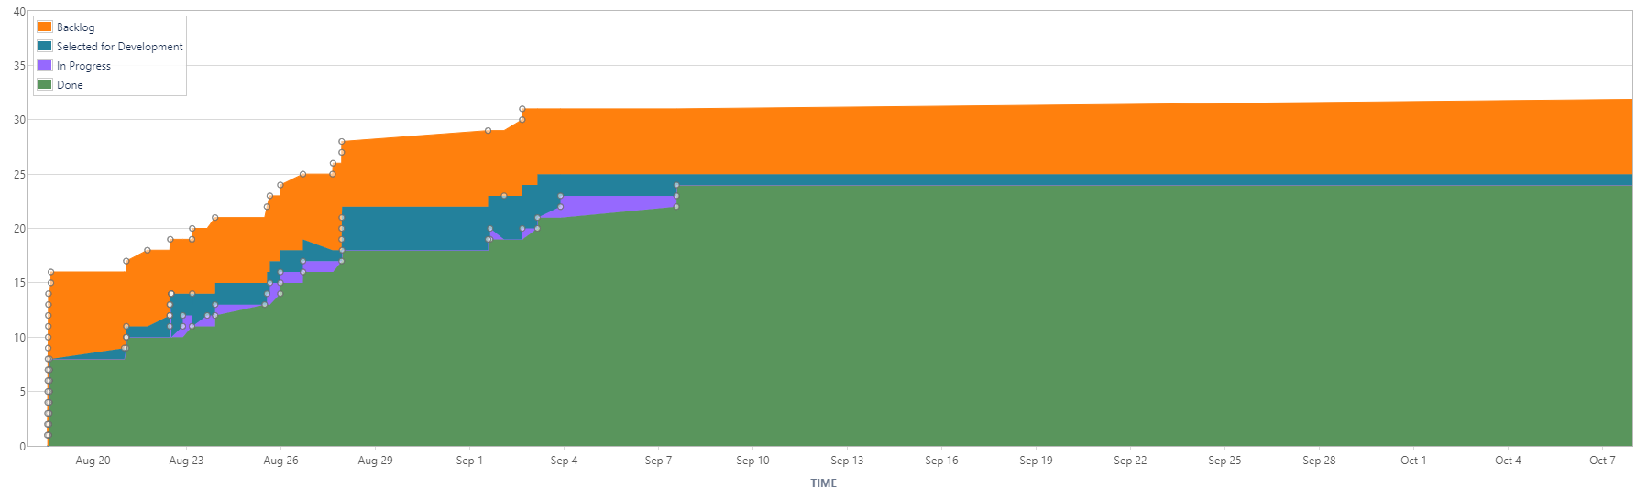
Summer Work - Overview
~30+ Jira issues created with ~22 completion
Project hierarchy created – Game Engine, Game

Slide 4
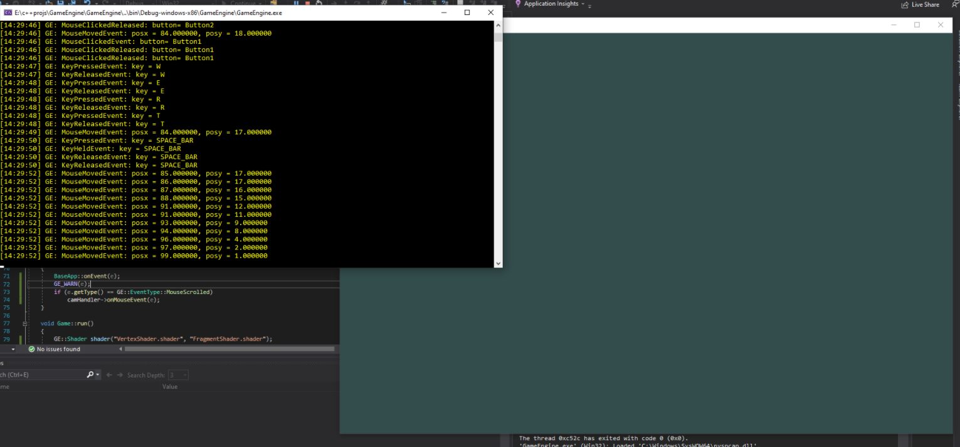
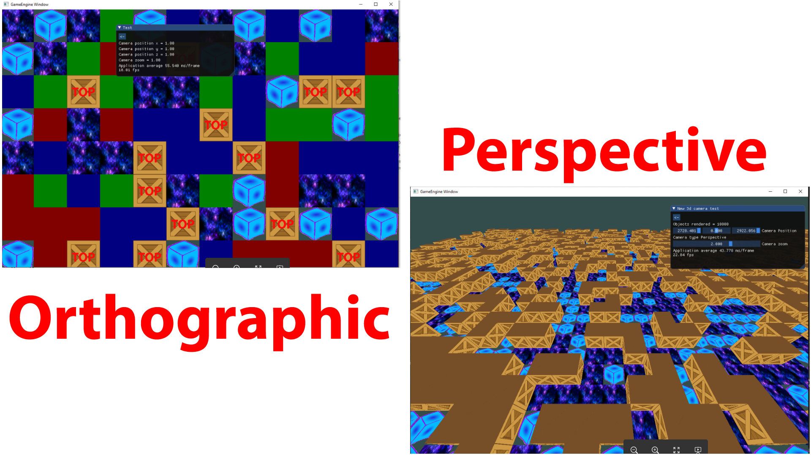
Summer work summaries
Created initial project, and implementing logging subsystem (fig1) _{[1]}
Created Event subsystem (fig 1) _{[2]}
Rendered basic shapes in procedural programming (fig 2) _{[3]}
Abstraction of rendering related methods into classes _{[4]}
Created primitive classes, shape geometry _{[8]}
Introduced testing environment – ImGui (fig 2) _{[7]}
Created Camera classes, Orthographic & Perspective projection (fig 2) _{[5] [6]}
Optimized rendering cycle with batching and instancing (fig 2) _{[9]}
Fig 1
Fig 2

Slide 5
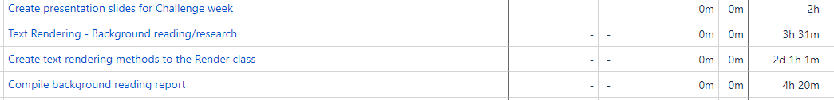
Challenge Week Work
Created background reading document, 4h 20min spent
Rendering text to screen, 15 hrs given, 20hrs 30min spent _{[10]}
This, 2h spent

Slide 6
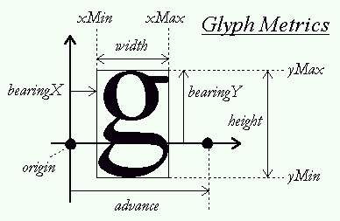
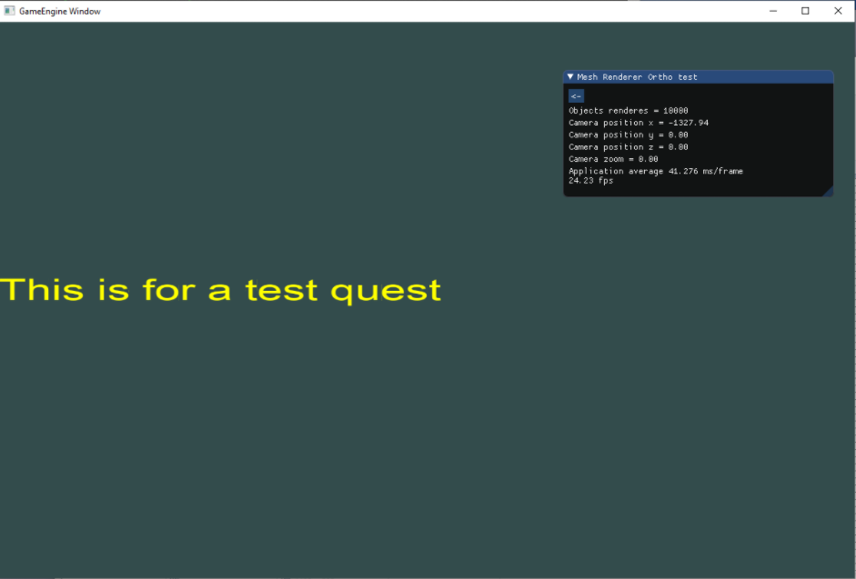
Challenge Week Work – Rendering Font
FreeType library used
FFT font loaded
Face containing character set
Characters extracted to glyph’s (fig 1)
FontLoader class instantiates GlyphAtlas
FontRenderer singleton state machine to setup atlas and color
FontRenderer.renderText(args…) to render text (fig 2)
Namespace ‘GE::Graphics::Fonts’
Fig 1 [11]
Fig 2

Slide 7
Queue Background Reading
Git commit 9115b8f7f78694bbeac407ab4b6208fa2a2b0cf9
Location root/Assignment Related/Reading/Ma18533_1802882_CE301_Background_reading.docx

Slide 8
Where Next?
GameEngine
Text improvements
Bounding box to automatically size text
Fix bleeding
Mouse coordinates - screen to world projection
Could use framebuffer for detecting objects under mouse?
AudioController subsystem
Layers/Panels
Shading and lighting, including diffuse textures etc
Refactoring/Cleanup
EntityController/Scene graph (may not implement)
Cataloguing render-able objects
spatial partitioning
Game!

Slide 9

Thank You! Questions?
Michael Allport
Ma18533
1802882

Slide 10
Git Commits / links / reference
[1] b7de4b9f1fc1e8b7402f9a5949ca46b17c84863f , e532e0b3efc38f9334bf792158b250fff24f6a41
[2] 006d9f6f36817139a0cb4101e76c39285a54b3d2, 2165f2a7b7e8124d590ad51844b7f44bce8f2020, 01179555de624d060fc5d731ca589723d7649fe7, f89cb8a4e1c93650b0de9d1925dd61b5fb050d46
[3] b0e7fe1001b3232ffe24c283c1aa59f72726b585
[4] 9b7c479cbd8a5727ae55452952d8af2e11e2550c, 9a98e3b21829e7e0b63c6b98a188796791adb760, b0e7fe1001b3232ffe24c283c1aa59f72726b585
[5] d219373ec92950dd51f746c9f7e3a4726e1b3df1
[6] c25a59d0a13485c891cf7d29694f91297daa5466, 8bd80769fe1a49ffcfc61b0d118101ca5a75e808, 8bd80769fe1a49ffcfc61b0d118101ca5a75e808, 181018b38d250534e34f91e01d7bfa77a6d31b44
[7] 46ec08b79243762b10278cd0efa4401f62b2d7db
[8] 57f6884292cbb30764d2f7af3f45a0f3ec758ac5, 9d8c1740f732f285e955b32661b4aa03e5741192, 107bdcc49d3a2c855d2692ef5b393a738b46a259, e8fcfe0d33cea855b7608781d3bb80b67fa9b671, 2ff609e678706af2bd3276dab22603c7b09ce496, 8bd80769fe1a49ffcfc61b0d118101ca5a75e808
[9] 2c298cec97ce5a69ff9dce428c091802b82f4693
[10] 922e936cc44cc17abe390bb8efa8cdb8e184ebcf, 369564366a482b586d65bdd8248c525eba14667e, 909571cdda7ec409554a8039fd6e290104f46062, 7c8fb04bac28ec02ca91306e7ea7871bf508b681, 381ded128083b5261b9ab594a41c703100d33354
[11]"OpenGL Programming/Modern OpenGL Tutorial Text Rendering 02 - Wikibooks, open books for an open world", En.wikibooks.org, 2020. [Online]. Available: https://en.wikibooks.org/wiki/OpenGL_Programming/Modern_OpenGL_Tutorial_Text_Rendering_02. [Accessed: 15- Oct- 2020].

